Slide 1
Lecture Contents
What is computer
Computer Hardware and Software
What is transistor
Other Electrical Components
Electrical Circuit
Electrical Component Integration
Logic gates
Microchips in daily life
Sand to Silicon

Slide 2
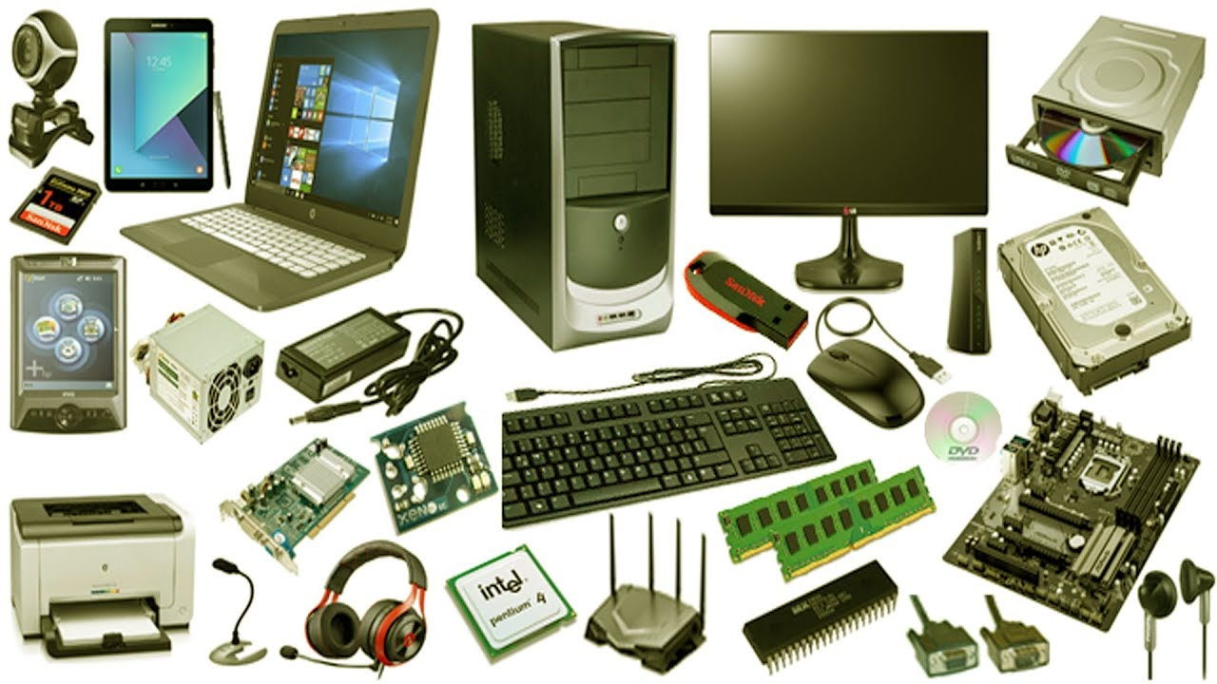
Computer Hardware
Introduction to computers

Slide 3
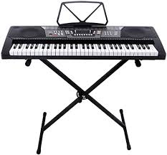

What is Computer?
A computer consists of two parts
Hardware and Software
Hardware is just like piano and software is like music it generates
Hardware does what is instructed by software
Hardware
The computer components that you can touch, feel
Software
The set of instructions for computer to perform a task,
the way signals should be transformed from one form to another

Slide 4
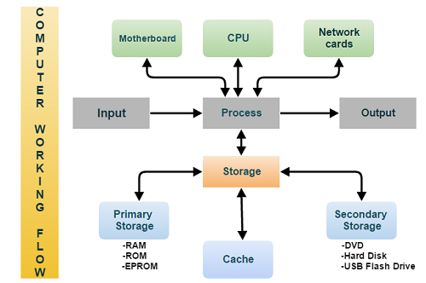
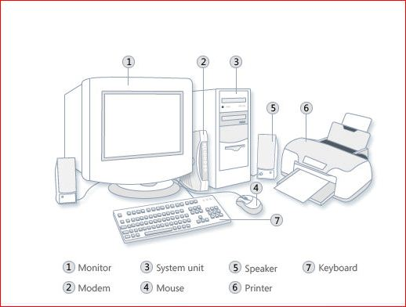
The Computer Hardware
The computer is general purpose technology
Computer system
It is a basic, complete and functional hardware and software setup with everything needed to implement computing performance
Computer Types
Analog Computers
Digital Computers
Hybrid Computers

Slide 5
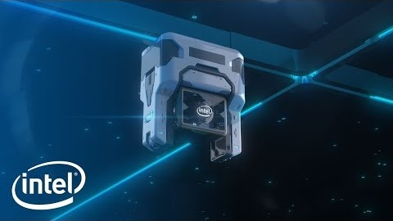
From Sand To Silicon

Slide 6
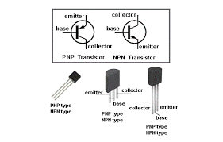
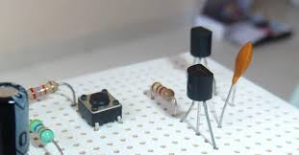
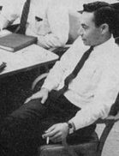
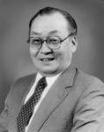
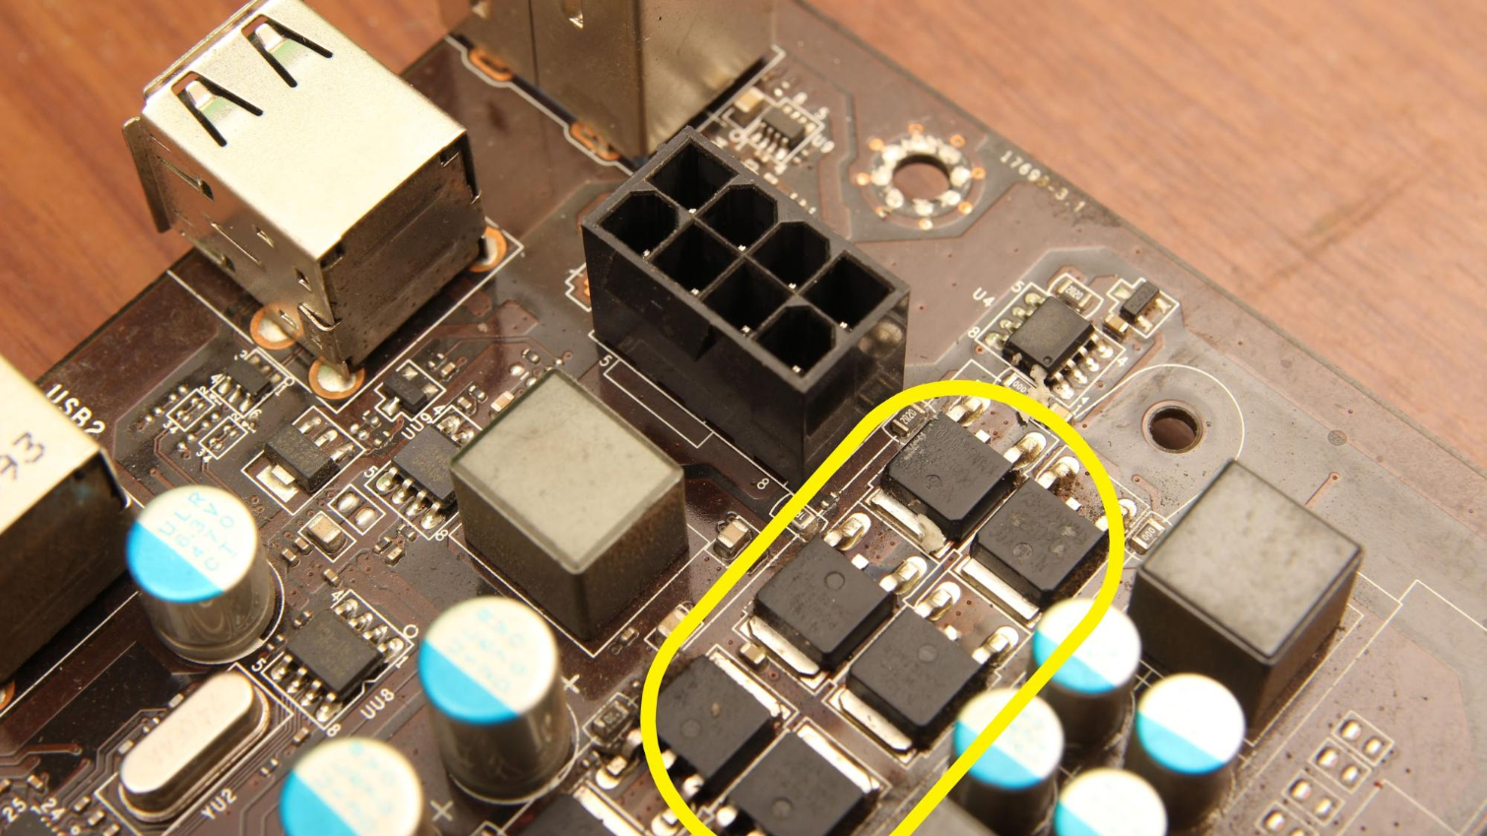
Transistors
It is a semiconductor device used to amplify or switch electronic signals and electric power
Amplification: It can enhance current amplitude
Switching: It can turn on and off the signal
Transistors have revolutionized the field of electronics
Transistors are solid state i.e. no moving parts are there
Design and development of smart and small sized electronics are possible due to transistors
There are number of transistor types
MOSFET
Bipolar
…
Mohamed Atalla (left) and Dawon Kahng (right) invented the MOSFET in November 1959.

Slide 7
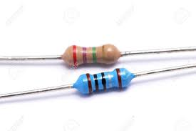
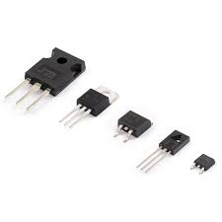
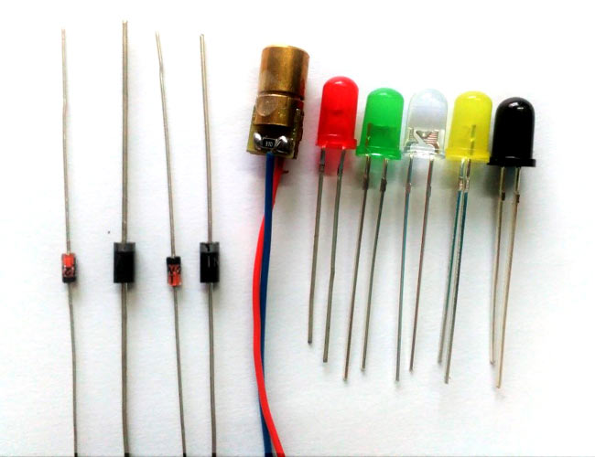
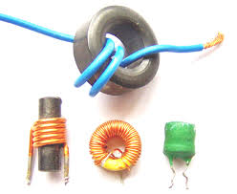
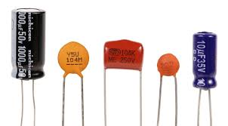
Electric Components
Electric Components
Small electronic parts that can perform tiny tasks
Examples: resistors, transistors, capacitors, inductors, diodes

Slide 8
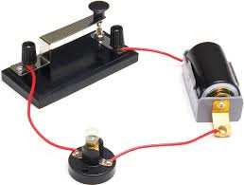
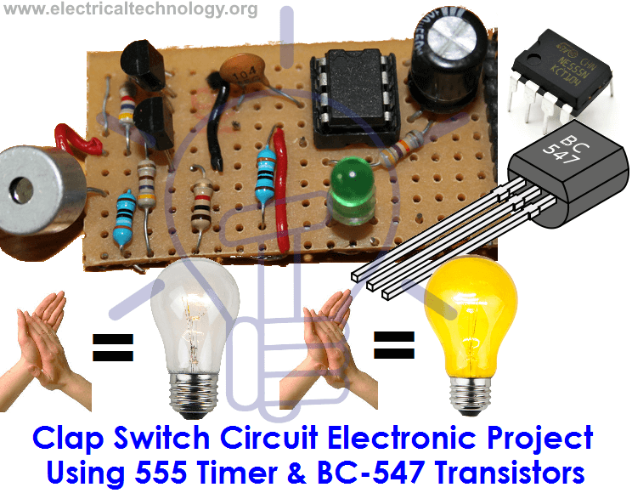
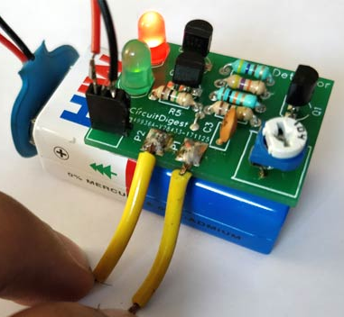
Electric Circuits
Electric Circuit:
It is composed of individual electronic components connected by conductive wires through which electric current can flow

Slide 9
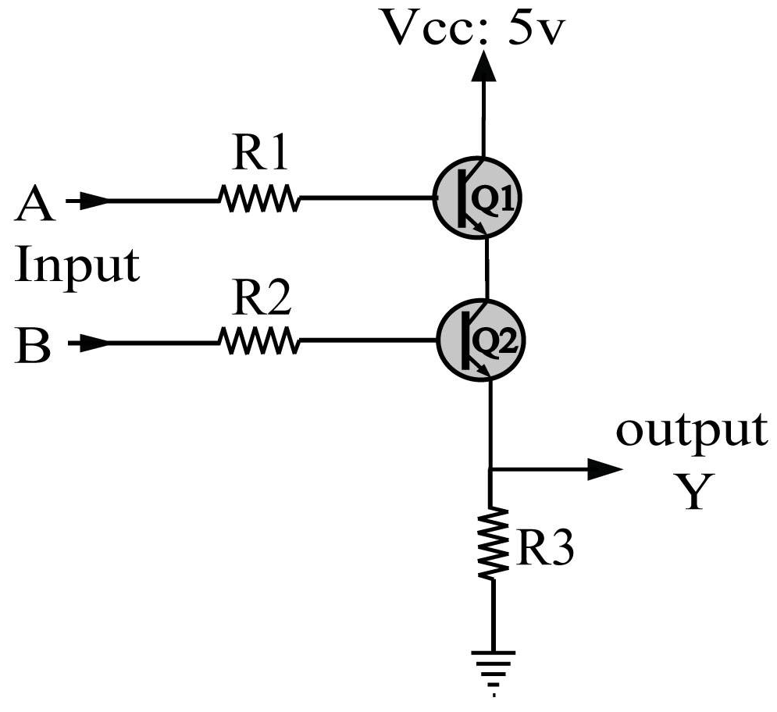
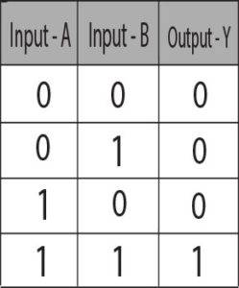
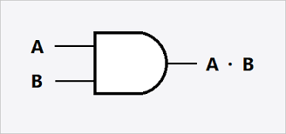
The logic gates
A logic gate is building block of digital circuit
Logic gates are electronic circuits that have inputs and outputs
Most of the gates have two inputs and an output
They can perform basic mathematical operations
The figure shows the AND gate
There are number gates used to build digital circuits
OR gate
EX-OR gate
NOR Gate
NOT Gate
…
The gates are represented with the help of symbols like AND gate is shown as

Slide 10
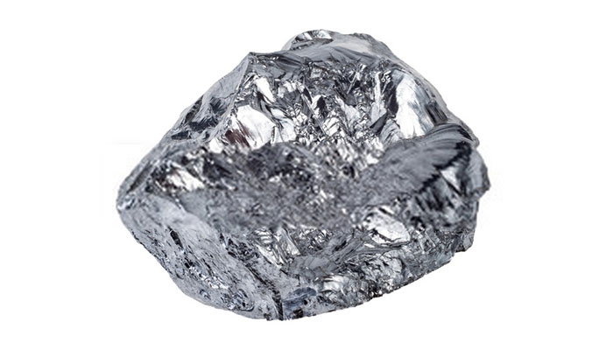
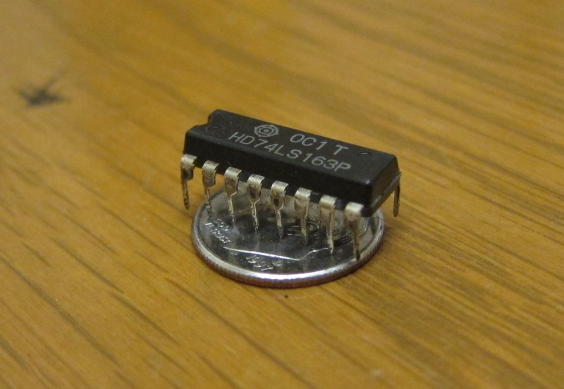
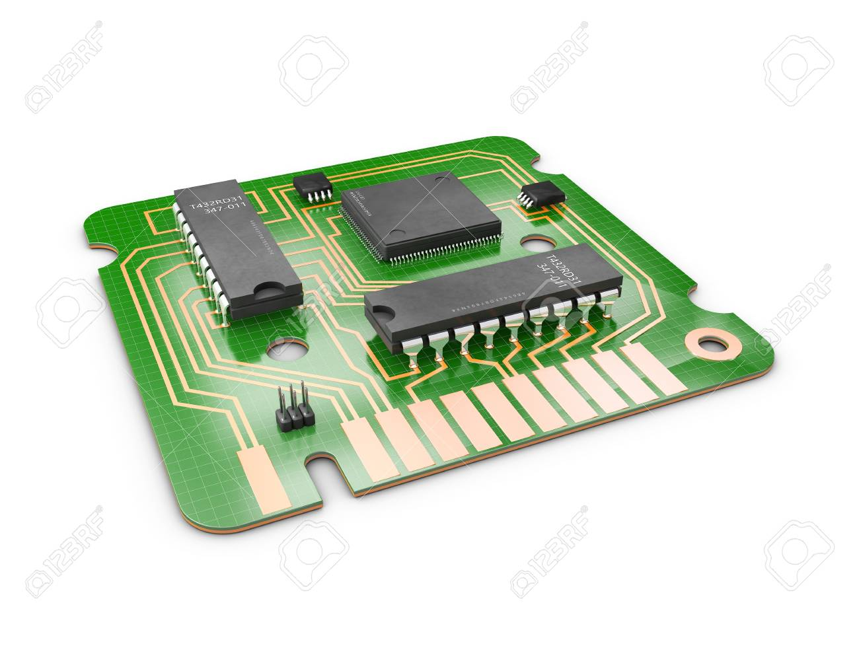
Integration
Integration
The process of fabricating a large number of electrical components on a small sized circuit
Integrated Circuit (IC)
An integrated circuit is a circuit or set of circuits made on thin substrate of silicon using hundreds or thousands of electrical components
Such a circuit takes the form of small single circuit known as chip, microchip or micro-electronic chip
Microscopic transistors are imprinted onto silicon chips
Chips can contain billions of transistors
Chips are packaged in plastic, with little metal legs
e.g. CPU chips, memory chips, flash chips

Slide 11
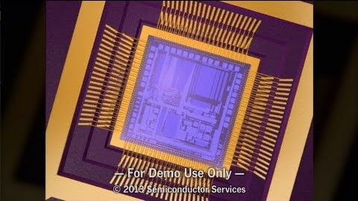
How chips are made
Thanks to the YouTube video provider

Slide 12
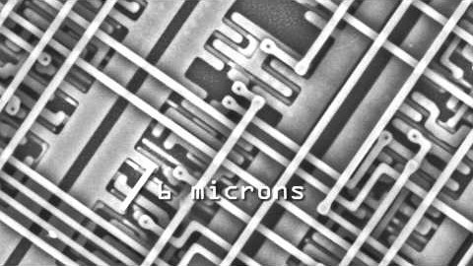
What is inside Chip

Slide 13
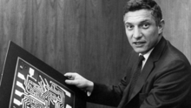

Integrated Circuits
Integration | Year | Transistors | Logic gates
Small Scale Integration (SSI) | 1964 | 1-10 | 1-12
Medium Scale Integration (MSI) | 1968 | 10-500 | 13-99
Large Scale Integration (LSI) | 1971 | 500-20000 | 100-9999
Very Large Scale Integration (VLSI) | 1980 | 20000-1000000 | 10000-99999
Ultra Large Scale Integration (ULSI) | 1984 | 1000000 – above | 100000 and more
Robert Noyce invented the first monolithic integrated circuit in 1959
Mohamed M. Atalla’s silicon surface passivation process (1957) was the basis for the monolithic IC chip. He later proposed the MOS integrated circuit chip (1960)

Slide 14
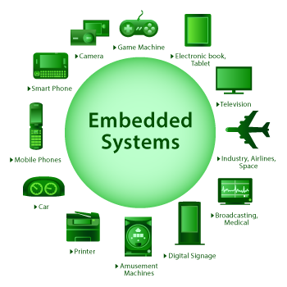
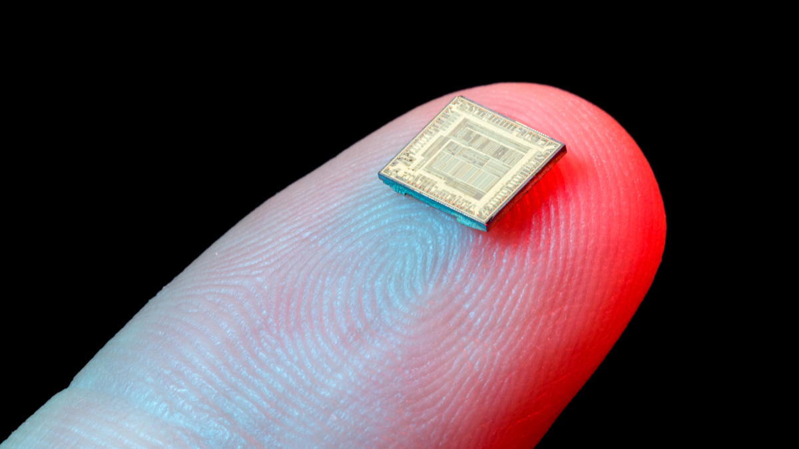
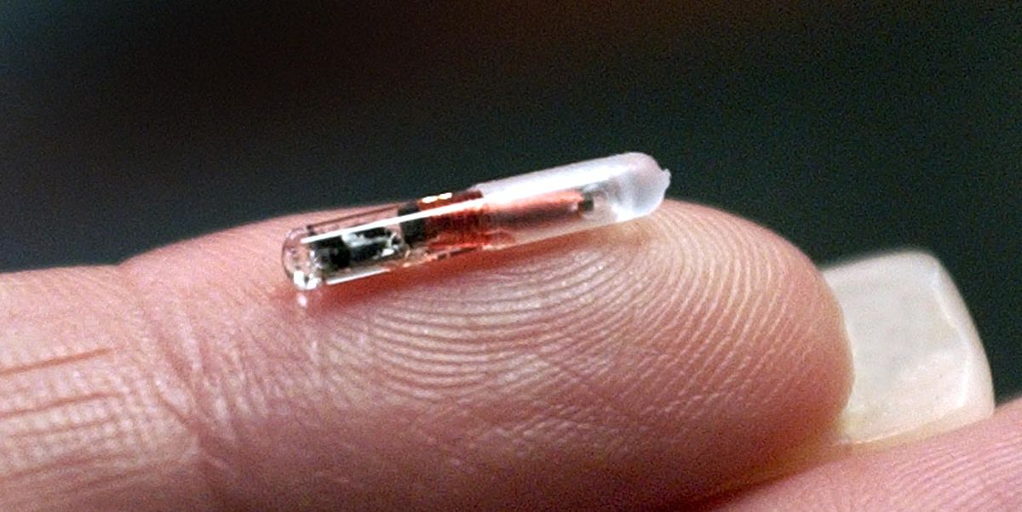
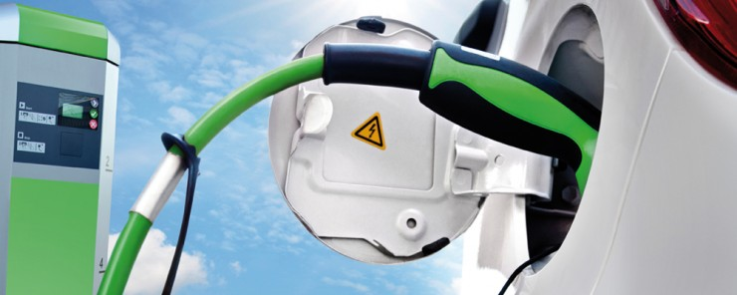
Microchips in daily life
Microchips are now every where in our life
The uses may include
Computes
Mobile Phones
Music Players
Digital watches
Video games
Smart Cards like
CNIC cards, ATM Cards
Robots
GPU Devices
Home Appliances
Vehicles
…

Slide 15
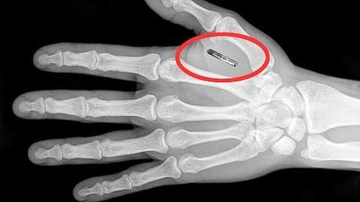
Microchips and Human Body Transplants

Slide 16



Thanks for watching
Dr. Sajid Iqbal
Assistant Professor
Department of Computer Science
Bahauddin Zakariya University, Multan
sajidiqbal.pk@gmail.com
https://github.com/sajjo79/Introduction-to-Computers
Allah Hafiz
COMEDXD

